Slide 1
Market Structure and Pricing Practices
MBA – Economics for managerial Decision making

Slide 2
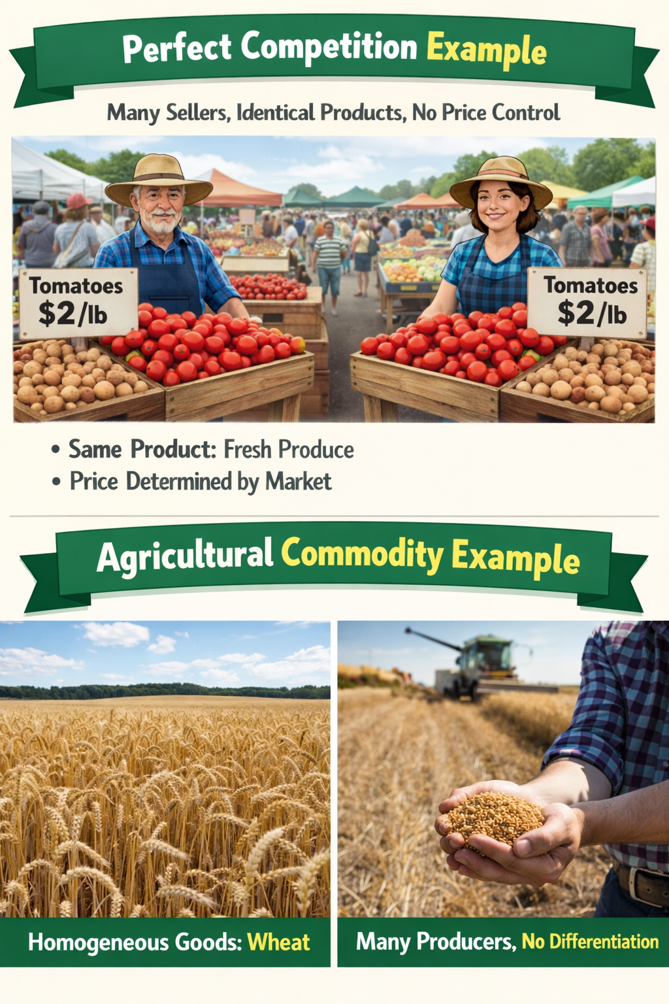
Perfect Competition
Meaning
Perfect competition is a market structure in which there are a large number of buyers and sellers, selling a homogeneous (identical) product, and no single firm can influence the market price.
The price is determined by the industry as a whole through the forces of demand and supply.
In this market, firms are price takers, not price makers.

Slide 3
Perfect Competition
Features (Characteristic)
Large number of buyers and sellers
Homogeneous product
Free entry and exit
Perfect knowledge (perfect information)
Perfect mobility of factors of production
No selling costs
Price taker firms
Uniform price

Slide 4
Features (Characteristic)
1. Large Number of Buyers and Sellers
There are so many buyers and sellers that no individual buyer or seller can influence the market price. Each firm’s share is very small.
Example: Thousands of farmers selling wheat or rice in mandis.
2. Homogeneous Product
All firms sell identical products in terms of quality and features. There is no brand differentiation.
Example: Raw milk, unbranded salt, basic agricultural crops.
3. Free Entry and Exit
Firms can enter or leave the industry freely in the long run. This ensures normal profit in the long run.
Example: Anyone can start or stop selling vegetables in a local market.
4. Perfect Knowledge (Perfect Information)
Both buyers and sellers have complete information about price and quality. No one can charge a higher price.
Example: Online commodity prices available to all traders.

Slide 5
5. Perfect Mobility of Factors of Production
Factors like land, labour, and capital can move freely from one firm to another.
Example: Labourer shifting from rice farming to wheat farming
6. No Selling Costs
There is no need for advertising or sales promotion because products are identical.
Example: Farmers do not advertise wheat or rice.
7. Price Taker Firms
Each firm accepts the market price. It cannot fix its own price.
Example: A small gold trader cannot change gold price.
8. Uniform Price
A single price prevails in the market for the same product.
Example: Same share price for all investors in stock market.

Slide 6
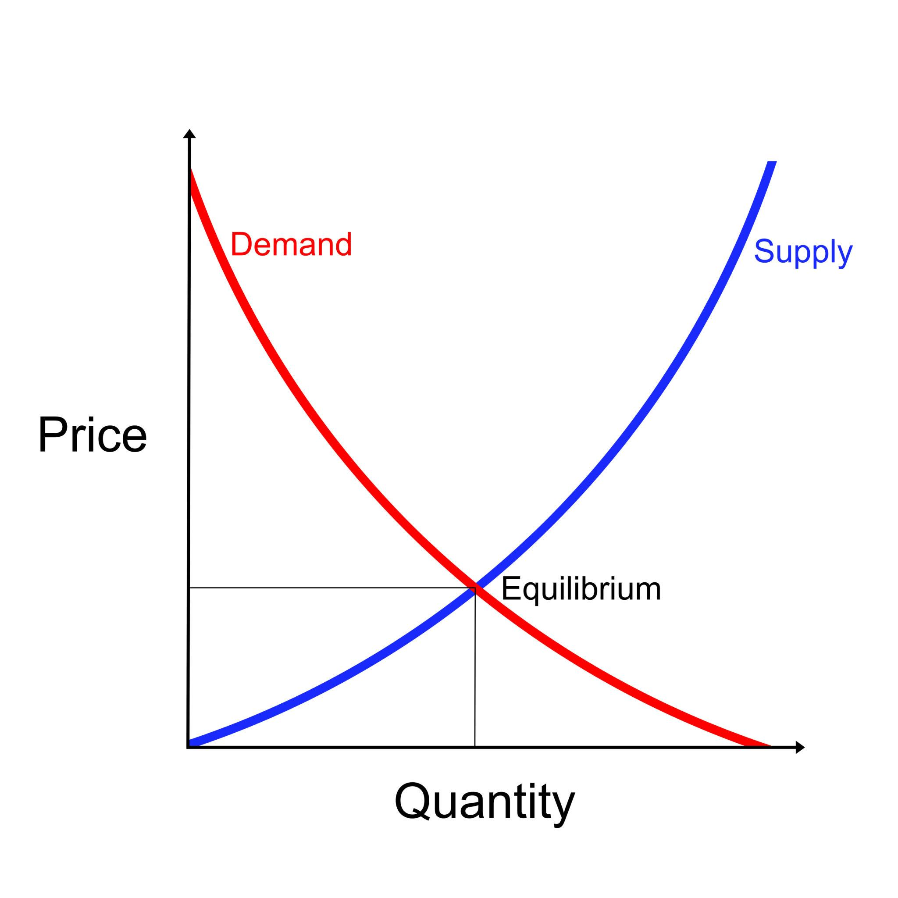
Determination of Price under Perfect Competition
Price is not fixed by a firm.
It is fixed by the entire market.
Where Demand = Supply, price is determined.
This price becomes the market price.
If wheat demand increases, price rises.
If supply increases, price falls.
So:
Market → decides price
Firm → accepts price

Slide 7
Determination of Price under Perfect Competition
Firm Cannot Change Price (Price Taker)
There are many sellers.
All sell identical products.
If one firm increases price → customers go to others.
If it reduces price → no need, it can sell everything at market price.
So the firm simply accepts the market price

Slide 8
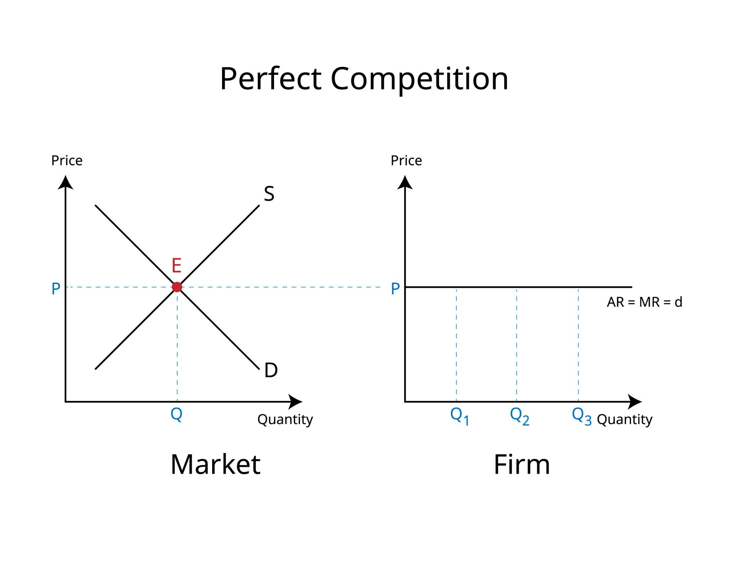
Firm Decides Output Where:
P = MR = MC
Market gives price.
That price becomes:
AR (Average Revenue)
MR (Marginal Revenue)
So:
Price = MR
Firm produces where:
MR = MC
So final condition:
P = MR = MC

Slide 9
Short Run Situation
a) Super Profit
Price > Cost
Firm earns extra profit
b) Normal Profit
Price = Cost
No extra profit
c) Loss
Price < Cost
Firm still produces (to cover some costs)

Slide 10
Long Run Situation
If firms earn profit → new firms enter
If firms incur loss → some firms leave
This continues until:
Only NORMAL PROFIT remains
So in long run:
Price = MC = AC

Slide 11
Monopolistic Competition
Features
Large number of buyers and sellers
Product differentiation (products are similar but not identical)
Some control over price (price maker to a limited extent)
Free entry and exit of firms
Heavy advertising and selling costs
Downward sloping demand curve
Non-price competition (branding, quality, service)
Only normal profit in the long run
Large number of firms
Product differentiation
Some control over price
Free entry and exit
Selling and advertising costs

Slide 12
Pricing under Monopolistic Competition
Firm has Some Price Control
Unlike perfect competition, firms are not price takers.
Because products are differentiated (brand, quality, service), firms can charge a slightly higher price.
But price control is limited because many competitors exist.
Different shampoo brands
Restaurants in the same area
Clothing brands
Each can charge a different price due to branding.

Slide 13
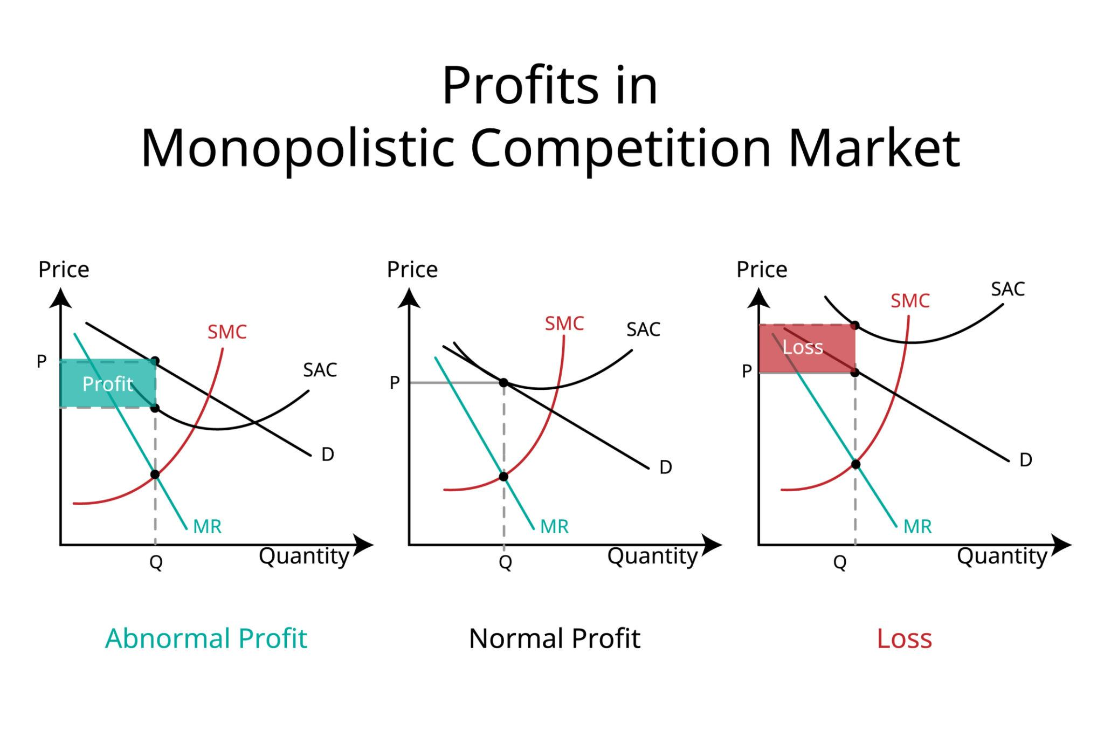

Slide 14
Product Differentiation
Product differentiation means firms sell products that are similar in use but made different in style, quality, brand, or features so customers feel they are not exactly the same.
Because of this differentiation, each firm gets:
Some customer loyalty
Some control over price
Toothpaste brands (Colgate, Close-Up, Sensodyne)
Shampoo brands (for dry hair, anti-dandruff, herbal)
Restaurants in same area but different taste and style
Clothing brands with different designs and quality

Slide 15
Demand Curve is Downward Sloping
Product is not identical.
Customers have brand preference.
If price increases → some customers leave.
If price decreases → more customers buy.
So, unlike perfect competition:
Firm faces its own demand curve.
Meaning:
To sell more, firm must reduce price.

Slide 16
3) Price > MC
Firm has some monopoly power.
So it charges a price higher than marginal cost.
Condition for profit maximization:
MR = MC
But:
Price is taken from demand curve.
So:
Price is always greater than MC
This is the profit margin due to branding.

Slide 17
4) Short Run: Profit Possible
In the short run, three situations can happen:
Super profit (brand popular)
Normal profit
Loss (new or weak brand)
A new café may earn high profits if very popular.
5) Long Run: Only Normal Profit
When firms earn profit:
New firms enter the market.
Competition increases.
Customers get more choices.
Demand for each firm decreases.
Finally:
Extra profit disappears.
Firms earn only normal profit.

Slide 18
Key Difference from Perfect Competition
Perfect Competition:
No price control
Price = MC
Monopolistic Competition:
Some price control
Price > MC
Due to brand value

Slide 19
Features of Oligopoly
Few large firms dominate the market
Interdependence among firms
High barriers to entry
Product may be homogeneous or differentiated
Firms have some control over price
Non-price competition (advertising, branding, service) is common
Possibility of collusion (cartels or price leadership)

Slide 20
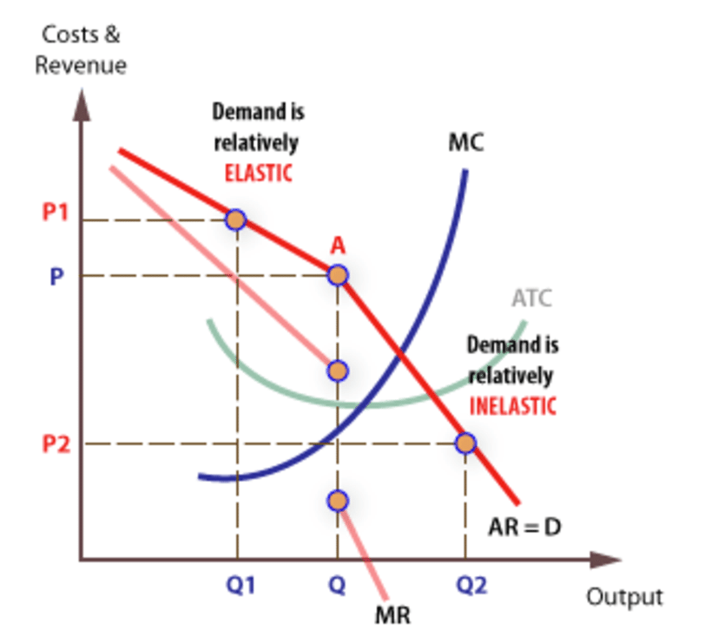
Kinked Demand Curve

Slide 21
Kinked Demand Curve
If a firm increases price
→ Competitors will NOT follow
→ Customers shift to other firms
→ Firm loses market share
So firms avoid changing prices.
If a firm reduces price
→ Competitors WILL follow
→ Everyone reduces price
→ No firm gains much advantage

Slide 22
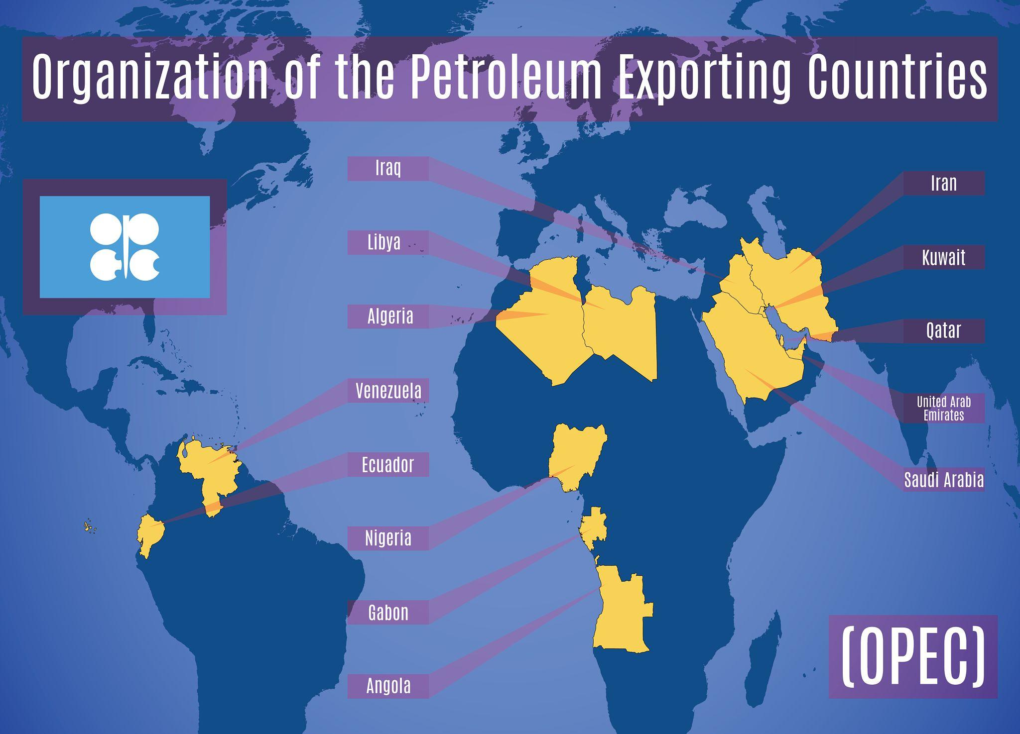

Cartels

Slide 23
Cartels
A cartel is when firms in an oligopoly secretly cooperate instead of competing.
They agree to:
Fix the price
Control production
Share the market
Goal:
Increase profit for all firms
Avoid price competition
So instead of fighting each other, they act like a single monopoly.

Slide 24
Price Leadership
Meaning:
Price leadership is a situation in an oligopoly market where one dominant firm sets the price, and all other firms in the industry follow that price.
Since there are only a few firms in oligopoly, they closely watch each other. Instead of competing aggressively by changing prices, they prefer to follow a common price set by the leading firm.
Telecom industry:
If a major telecom company changes recharge plan prices,
Other companies soon introduce similar pricing.
Petrol prices:
One company revises prices,
Others follow the same pattern.

Slide 25
Monopoly
Features
Features of Monopoly
Single seller in the market
Large number of buyers
No close substitutes for the product
Firm is a price maker
High barriers to entry
Full control over supply
Downward sloping demand curve
MR is less than price (MR < AR)
Can earn supernormal profits in the long run
Strong control over pricing policy

Slide 26
Pricing under Monopoly
1) Firm is a Price Maker
In monopoly, there is only one seller.
No close substitutes.
So the firm has full control over price.
It can decide the price by adjusting output.
If the monopolist produces less → price rises
If it produces more → price falls
So:
Firm controls price by controlling supply.

Slide 27
5) Can Earn Long-Term Profits
This is the biggest difference from other markets.
In monopoly:
No competitors
No entry possible (due to patents, high cost, legal barriers)
So:
Firm can keep earning supernormal profits even in long run
Patented medicines
Government monopolies
Unique technology owners

Slide 28
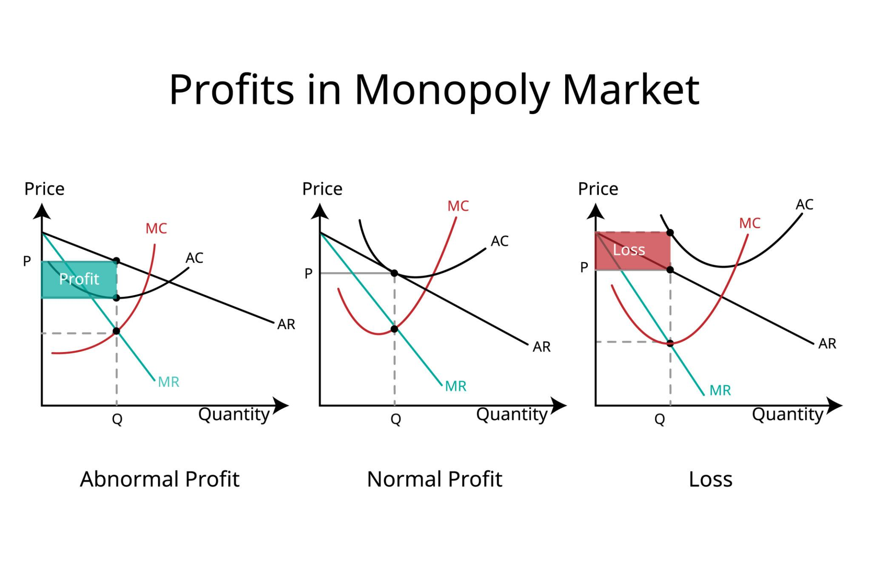

Slide 29
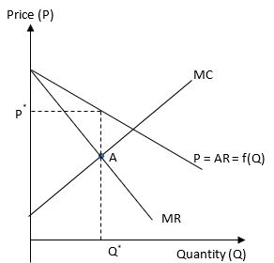

Slide 30
2) Demand Curve is Downward Sloping
Since the firm is the only seller, it faces the entire market demand.
To sell more units, it must reduce price.
To charge a higher price, it must sell fewer units.
So demand curve slopes downward.

Slide 31
3) MR < Price
To sell one more unit, the monopolist must reduce price.
That lower price applies to all units sold.
So:
Extra revenue (MR) is less than price.
That’s why in the diagram:
MR curve lies below the demand (AR/Price) curve.

Slide 32
4) Profit Maximization Rule
MR = MC
This is the key decision point.
Firm produces at output where MR = MC
Then it goes up to the demand curve
That gives the price to charge
So:
Output decided by MR = MC
Price taken from demand curve

Slide 33
Price Discrimination
Price discrimination means charging different prices for the same product to different customers, even though the cost of producing the product is the same.
This is mainly possible in:
Monopoly
Monopolistic markets
Service industries
Different customers are willing to pay different prices.
The firm tries to capture more profit from each group.
Instead of one price for all, it uses multiple prices.
Example:
A movie ticket:
₹150 for students
₹250 for adults
Same movie, same seat, different price.

Slide 34
Price Discrimination
1.First Degree (Perfect Price Discrimination)
Different price for each customer.
Firm charges the maximum each person can pay.
Bargaining in local markets
Car sales negotiation
2.Second Degree
Price depends on quantity consumed.
Bulk discounts
Buy 1 Get 1 offers
Electricity slabs:
  First 100 units cheaper
  Next 100 units costlier
3.Third Degree (Most Common – Very Important)
Different price for different groups/markets.
Student discounts
Senior citizen discounts
Airline pricing:Business class expensive,Economy class cheaper
Groups are separated based on: Age,Income

Slide 35
Loss Leader Pricing
Meaning
A firm sells one product at a very low price (sometimes even at a loss) to attract customers.
The aim is:
Bring customers into the shop/platform
Make them buy other profitable products
So the loss on one item is recovered from other items.
Examples
Supermarkets:
  Sugar, rice, or oil sold very cheap
Amazon/Flipkart:
  Big discount on one popular item
Fast food combos:
  Burger cheap → drinks & fries expensive
Companies use this to:
Increase store traffic
Attract new customers
Increase total sales
Risk
If customers buy only the cheap product → loss increases

Slide 36
Peak Load Pricing
Charging higher prices during high demand time and lower prices during low demand time.
This helps manage demand and increase revenue.
Examples
Ola/Uber surge pricing during rain or office hours
Electricity charges:
  Higher at peak hours
  Lower at night
Airline tickets:
  Expensive during holidays
  Cheaper during off-season
Use resources efficiently
Control overcrowding
Earn more during peak demand
This is common in service industries.

Slide 37
Transfer Pricing
Meaning
Price charged when one unit of a company sells goods/services to another unit of the same company.
So it is internal pricing, not market pricing.
Example
Tata Motors buys parts from another Tata company
A company's manufacturing unit sells to its own marketing unit
Even though both belong to the same company, they set a price for accounting purposes.
Why Companies Use It
Measure performance of each division
Calculate profit of each unit
Tax planning (sometimes)
Helps:
Evaluate department efficiency
Maintain internal cost control

